Slide 1
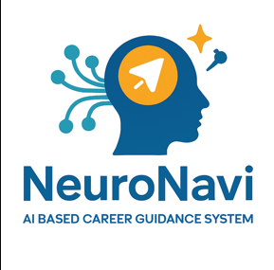
Indi Genius
Neuro Navi
Team Leader: Aryan Raghuvanshi
Team Members:
Chitraxi Porwal
Agrima Chaturvedi

Slide 2
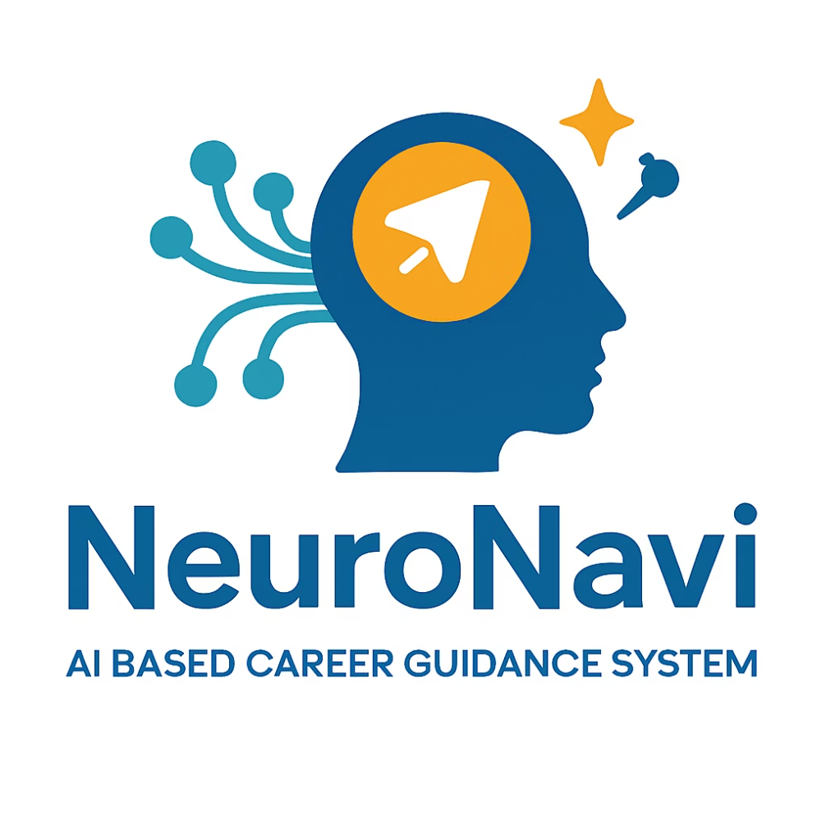
Neuro Navi: AI-Based Career Guidance System
Personalized career guidance powered by AI combines machine learning and real-time job market data.

Slide 3

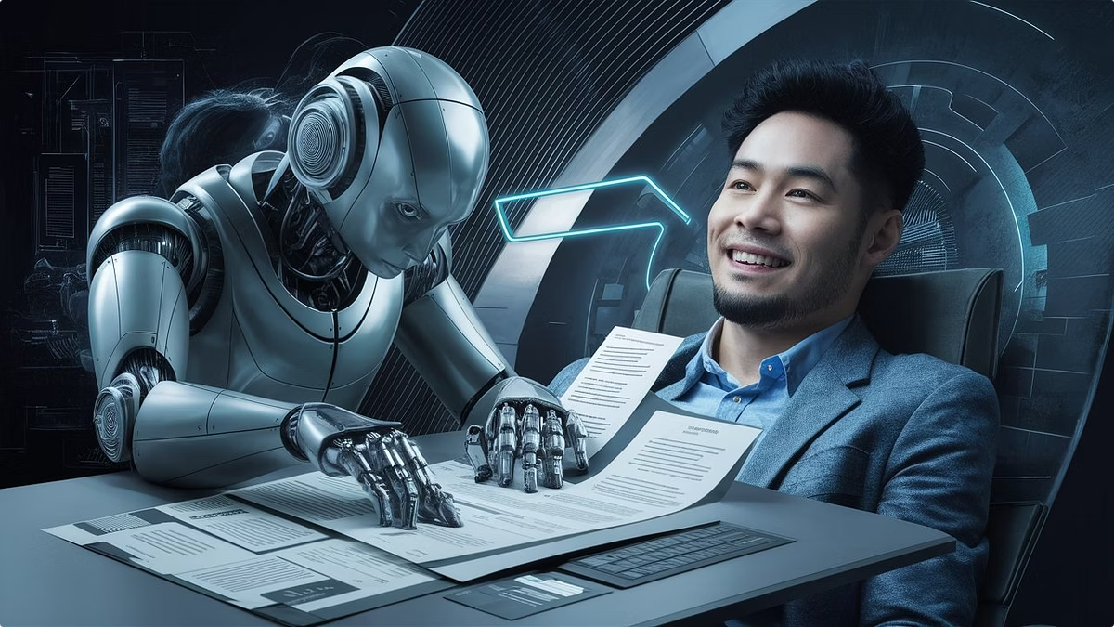
Challenges in Traditional Career Counseling
Lacks Personalization
Generic advice fails individual needs
Not Scalable
Limited reach and capacity for counselors
Outdated Market Insights
No real-time industry trend updates
Career Preparation Gaps
Challenges in resume and interview readiness

Slide 4
Objectives of Neuro Navi
Machine Learning Predictions
Real-Time Industry Insights
Forecast optimal career paths
Integrate Glassdoor and Indeed data
Skill Gap Analysis
Quiz Generator
Identify missing competencies
Data-driven reporting tools
Learning Path Suggestions
Career Doc Automation
Personalized growth plans
Resume and cover letter generation

Slide 5
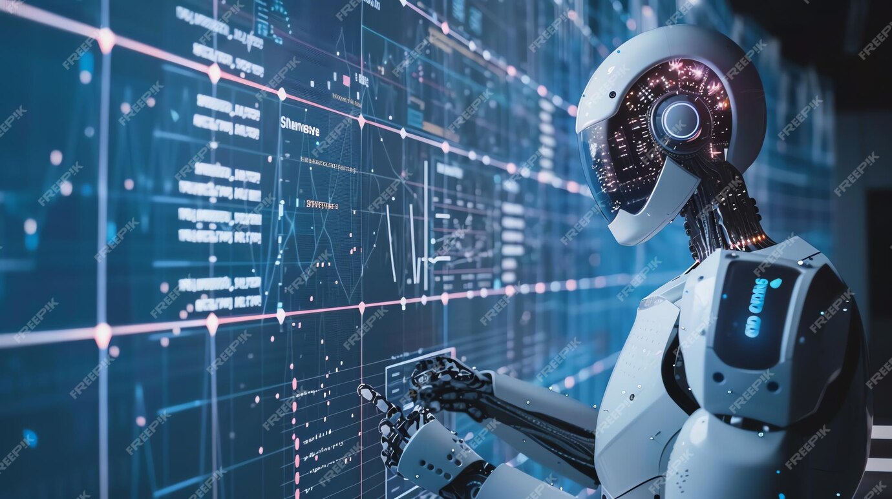
System Architecture Overview
1
Frontend
Next.js
2
Backend
Next.js , PostgreSQL (Neon cloud)
3
ML Engine
Distance Vector + Random Forest Model
4
Integrations
Glassdoor, Indeed, Gemini API
5
User Auth
Clerk Authentication

Slide 6





Technologies Powering Neuro Navi
Python
Next.js
PostgreSQL
ML scripting and data handling
Frontend development with Next.js
Cloud-hosted data storage
AI/NLP APIs
Gemini, Glassdoor, Indeed integrations

Slide 7
Key Features of Neuro Navi
AI Career Predictions
Real-Time Market Insights
Tailored suggestions for users
Up-to-date job market trends
Skill Gap & Learning Plans
Resume & Interview Tools
Targeted recommendations
Automated document and prep assistance
Cover Letter Generator
Automated personalized letter creation

Slide 8
Advantages and Potential Scope
Personalized Guidance
Market-Driven
Customized career advice
Dynamic, updated real-time data
Scalable & Secure
Wide User Base
Modular architecture
Students to professionals
Future Roadmap
Multilingual, Agentic Ai & chatbot

Slide 9




Conclusion and Vision
Bridge Aspirations & Market
Comprehensive AI Solution
Agentic Ai
Deep learning, multilingual, feedback
Align career goals with demands
End-to-end career support

Slide 10
Thank You

